Slide 1


Preparing for Exams at IONA 2

Slide 2
Preparing for Exams at IONA
Study Spaces

Slide 3
Your time management
Where You Study Has an Effect on...
The accuracy of your work (less errors)
Work completion

Slide 4
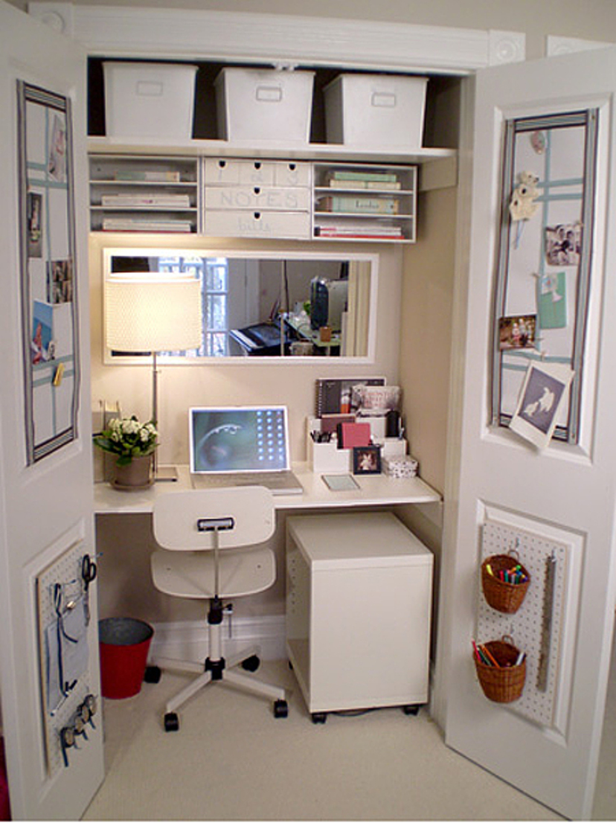
Setting Up Your Study Space
(Basic Requirements...)
Desk/table and chair
Access to power
A good light source
A comfortable temperature setting to ensure productivity.
Remove excess clutter to make use of the space that you have.
Remove anything that will distract you from your work.

Slide 5
WORK SPACE TIP
Setting up your work space to ensure productivity, is time well spent

Slide 6
Preparing for Exams at IONA
Study Skills

Slide 7
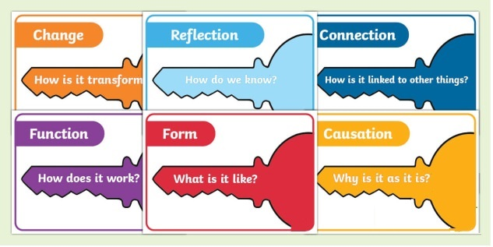
Big Ideas First
Start by focusing on KEY concepts
Notes:
You can use your textbook summary page to decide on what is key. Pretend you are making a cheat sheet. What info would you include.

Slide 8

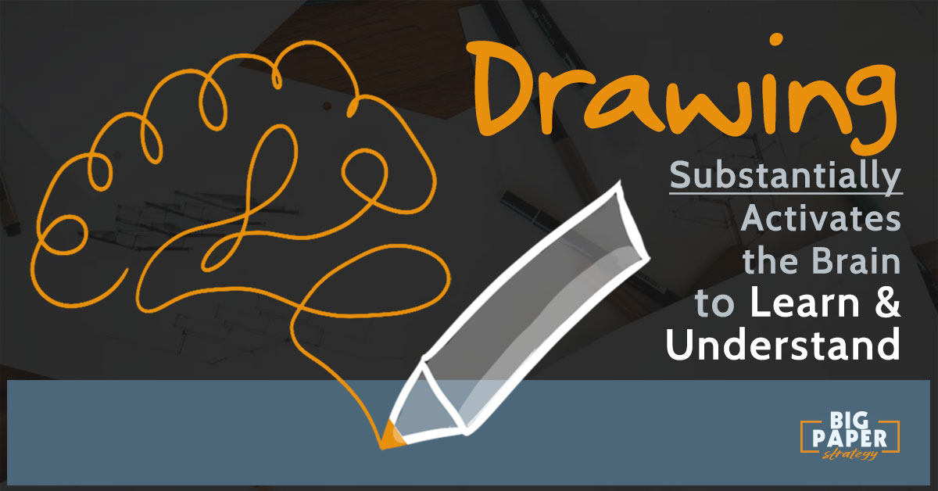
UNDERSTAND Concepts
Don’t just memorize information
Try to understand what is happening and why
Draw Diagrams
Notes:
Diagrams of concepts require understanding of the material rather than just rote memorization

Slide 9
IT’S ALL ABOUT THE RECALL
Force yourself to recall facts
Leave longer time intervals between when you recall these facts
Notes:
Studies show that the act of recalling information helps the information stick in your brain better.
So once you think you know it, leave it for a day and then try to recall it. Then leave it for two days and try to recall it again.

Slide 10
Mnemonics and Phrases
Remembering Techniques
Analogies
Flashcards
Notes:
Phrases like righty tighty, lefty loosey
Stories or analogies to help you remember ideas
Use post it notes or flashcards – have them handy. Use them while on the bus, brushing your teeth, etc

Slide 11

Don’t Do it Alone
Form study groups, to quiz each other
Teach someone what you’ve learned

Slide 12

PRACTISE, PRACTISE, PRACTISE
Do many practice questions
Practise them with a time limit
Notes:
The more practice you get, the easier it is to remember what to do
The time limit gives you practice in recalling information with a time limit. Similar to scrimmages in sports or rehearsals in recitals.
Studies show that it is normal to “blank” out during stressful, pressure packed situations. Practicing makes test and exam situations less stressful

Slide 13

Things to AVOID
Don’t just “read” over your notes
Don’t just rewrite your notes
Notes:
Studies show reading over your notes is the WORST way to remember information.

Slide 14
Remember
Study Smarter, not Harder
Notes:
There is limited time. Make efficient use of how you study.

Slide 15
Preparing for Exams at IONA
Test Taking Skills

Slide 16
DO WHAT YOU KNOW
Skim the whole test/exam first
Start with the questions you definitely know
If you’re stuck on a question, skip it and go back later
Notes:
Time is limited. Don’t waste time mulling over a question you don’t know. That leaves less time for you to answer the questions you do know.
Sometimes while answering one question, it will remind you how to do another.

Slide 17
Knowledge Dump
Write down what you know
  Mnemonics
  Acronyms
  Formulas
Notes:
Write the mnemonics or formulas you think you might forget this way when you don’t have to stress about remembering them while you are writing your test/exam

Slide 18
Look for the
Action Words
Read the questions to see what you are ASKED to do
Underline or highlight key words
Answer the question!!!
Notes:
Look for words like compare, explain, describe – these words tell you what you are asked to do.
Don’t just write everything you know about a topic. Use the verbs to make sure you answer the question.

Slide 19
Make A Plan
Scan your exam/test to see how much time you should spend on each question
Use all your time
Notes:
Essays worth 40 marks should take up more time than questions worth 10 marks.
If you finish early spend the time going over the questions again.

Slide 20


