Slide 1


Preparing for Exams at IONA 1

Slide 2

BELIEVE IN YOURSELF
FIRST AND FOREMOST

Slide 3


Slide 4
Preparing for Exams at IONA
Time Management

Slide 5
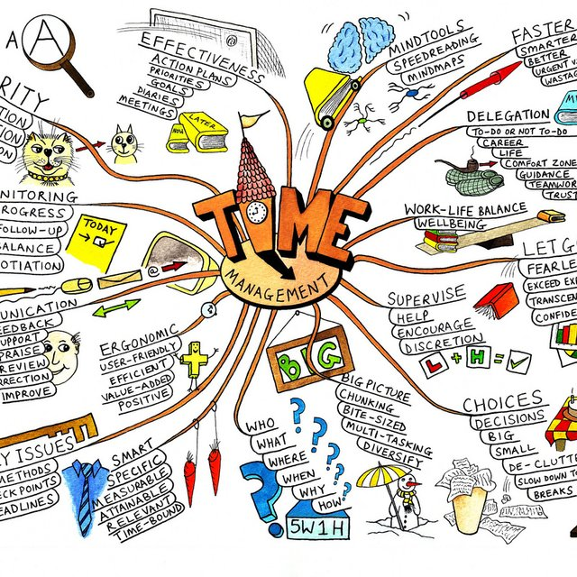
How Well Do You Manage Your Time?

Slide 6
Improved Productivity
Time
Management
Improved Grades
Improved Self Esteem

Slide 7
The most important way to balance
your school and personal life……
Create a schedule and follow it!

Slide 8
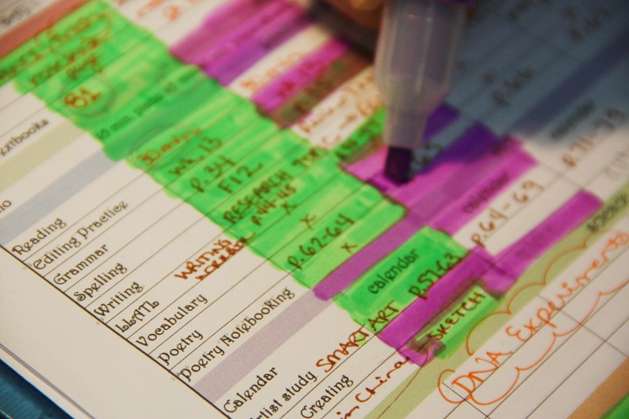
Create a to-do list.
Use a planner to keep track of important dates and work that needs to be done.
Consider colour coding to keep tasks organized.

Slide 9
To stay on track…
Prioritize
Do a little bit of work each day

Slide 10
It might be helpful to…
Set reminders to help you
keep to your study schedule.

Slide 11
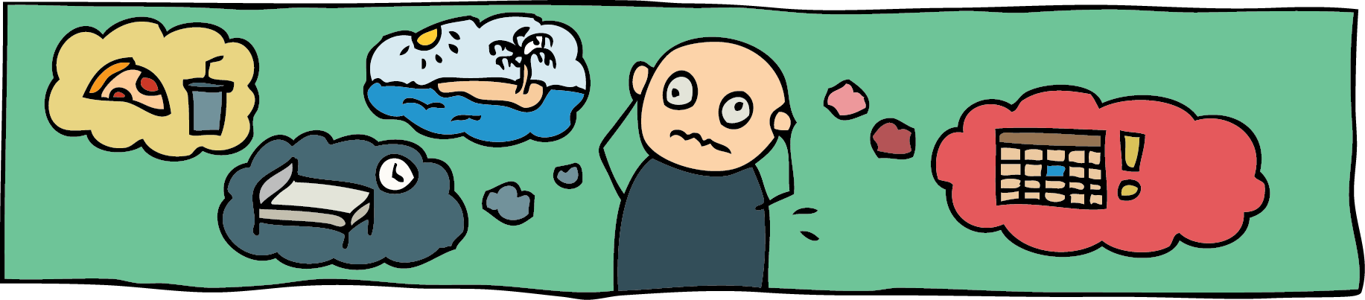
Distractions!
What Are Your Distractions?

Slide 12
Avoid Distractions
turn off devices
close tabs you are not using
only listen to music that helps
you to stay focused.

Slide 13
Avoid Distractions
find a place to work where you can be productive.

Slide 14

Take Breaks
It is important to plan your study periods. You know how you study best. One Suggestion:
Work 25 minutes.
Take a 5 minute break.
Repeat 4 times.
NEXT, take a 20 minute break

Slide 15
Be sure to set aside time to…
drink water
eat healthy
move around
sleep

Slide 16

Preparing for Exams at IONA
Note Taking Skills

Slide 17

WHEN to take notes
before a lecture; do assigned readings & prep by recording headings and questions you might have
during a lecture, while listening to your teacher
after each class, to clarify any vague points and consolidate what you read with what you heard

Slide 18
HOW to take notes: the different styles…
The Cornell Note-taking system
Brainstorming and Mind maps
The Outline Method for structured Note-taking
The Charting Method

Slide 19
1. The Outline Method: best for structured notes
For people who like simplicity.
One of the easiest ways to take notes; comes quite naturally to most people.

Slide 20
Formatting Your Page Using the Outline Method
A simple approach to taking notes. It helps you follow along and pay attention during class. Remember these key points:
Start by choosing four or five key points that will be covered in your class.
Beneath those points write some more in-depth sub-points about each topic as the teacher covers them.

Slide 21
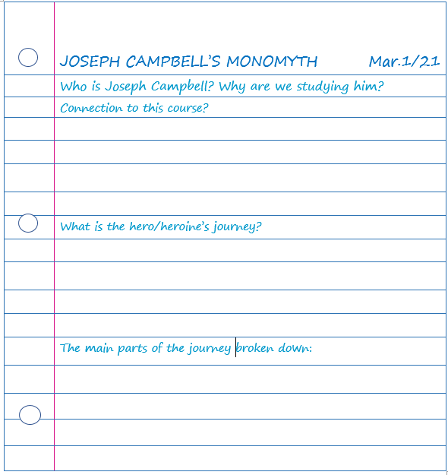
What your notes might look like using
The Outline Method….(spaces get filled in as you listen to the lecture)

Slide 22
2. The Cornell Method: best for reviewing
Effective way to structure your notes if you’re looking to get the most out of your review time.
In this method, you divide your paper into three sections: notes, cues, and summary.

Slide 23
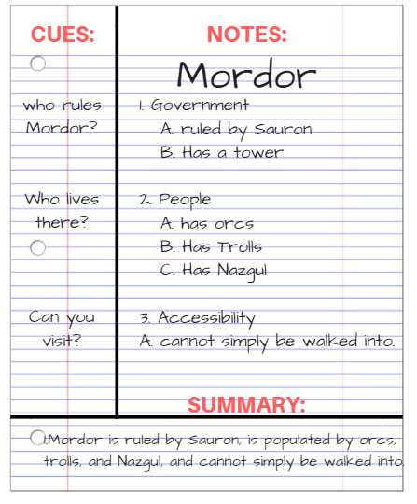
Also include the name of the task, the date, and the topic or title at the top of the page
Note the large column on the right for main notes
The smaller column on the left will be for questions or related information
The bottom section is where you summarize the day’s notes
Notes:
First , divide your page into three columns.
Make the column on the right side of the page larger. This is where you will take your notes.
Include a smaller column on the left side of the page. This will be for any questions you formulate.
Make a small row at the bottom of the page. This section will be used to summarize your notes. You may want to highlight important key points in your notes section; then copy those notes to the bottom row as your summary.
Complete the last column after class, or later in the day to help recall important information from your lesson.

Slide 24
3. The Brainstorming and Mind Maps
Method: best for visual learners
Good for those who like a visual representation of information and who take notes using pen and paper.
These methods use a graphic (pictorial) means of representing information. They work by relating each fact or idea to other facts or ideas.

Slide 25
Formatting Your Page Using the Brainstorming/Mind Map Method
Especially useful when taking notes from a textbook or reading
Begin in the middle of a sheet of paper.
Write the main topic and circle.
Draw lines from the circle for major facts
Draw lines fomr major facts for additional facts.
Notes:
Especially useful when taking notes from a textbook or reading because if you are reading critically, you know what is coming next and can organize your brainstorm/mind map accordingly
Begin in the middle of a sheet of paper.
Determine the main subject or topic. Write this title in the center of the page with a circle around it.
As major facts (subheadings) are presented that relate to the main subject/topic, draw lines out from the circle and label.
As additional facts are presented that relate to each subheading, draw these lines, linked to appropriate major fact and label.

Slide 26
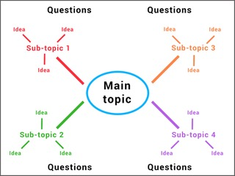
What your notes might look like using the Brainstorm or Mind Map Method:
Always Title and Date Note
Questions go around the edges
Different colours for different themes
Notes:
Use the space around the edge of the paper to pose questions or to clarify any points you think are vague or confusing
You can also use different coloured lines to connect different thoughts.

Slide 27
4. The Charting Method: best for organizing ideas
Helpful in a Math or Chemistry class because formulae can be written in the first column, with the examples written in the subsequent columns.
For lectures where there are going to be categories that are discussed (for example, a comparison of theories in a Psychology class)

Slide 28
Formatting Your Page When Taking Notes Using the Charting Method
Determine the categories to be covered.
Draw columns with determined categories as headings for each
Place the information from the lecture in the appropriate columns.

Slide 29
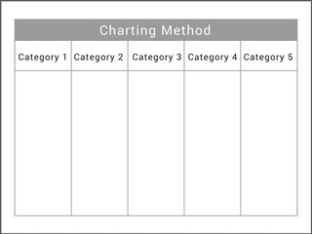
What your notes might look like using the Charting Method:
Can use when reviewing
Helps you become clearer with understanding
Re-organizing things so that you can see the relationships Puts things in a logical order
Easy for comparisons and relationships
Notes:
If you’re unsure if the charting method may be suitable for you, consider using it when you are reviewing your notes.
not only helps you to become clearer with your understanding but shifts your knowledge from your short-term to your long-term memory, too.
not only helps you to become clearer with your understanding but shifts your knowledge from your short-term to your long-term memory, too.
Also puts things in a generally logical order, so it is easy to create comparisons and relationships

Slide 30
WHAT to do with your notes
Taking good notes is not enough; it’s what you do with them that matters…..
Review your notes within the first 24 hours
Review a small portion of your notes every day. Don’t try to cram before your test/exam.
As you’re doing assigned reading or research, have your notes on hand and notice repetition. If it was covered in class and it’s in your assigned reading, there’s a good chance it’ll be used in some form of assessment.
Notes:
Review your notes within the first 24 hours after your lecture. This cements everything you heard and learned in your brain, so it won’t fall out of your head later.
Review a small portion of your notes every day. Don’t try to cram before your test. Reviewing over a long period time ensures that what you’ve learned will stick and improve your recall.

Slide 31
AND FINALLY,
Note-taking strategies need to be learned, developed, and maintained to be successful.

Slide 32
Stay Positive
You got this
IONA!

